Slide 1
PDAs Accept
Context-Free Languages

Slide 2

Theorem:
Context-Free
Languages
(Grammars)
Languages
Accepted by
PDAs

Slide 3
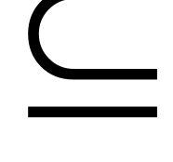



Proof - Step 1:
Context-Free
Languages
(Grammars)
Languages
Accepted by
PDAs
Convert any context-free grammar
to a PDA with:

Slide 4

Proof - Step 2:
Context-Free
Languages
(Grammars)
Languages
Accepted by
PDAs
Convert any PDA to a context-free
grammar with:

Slide 5
Convert
Context-Free Grammars to
PDAs
Proof - step 1

Slide 6


Take an arbitrary context-free grammar
We will convert to a PDA such that:

Slide 7


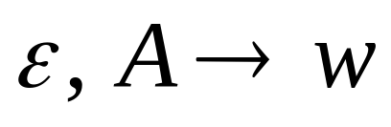
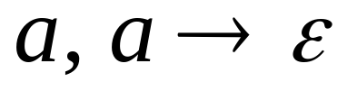
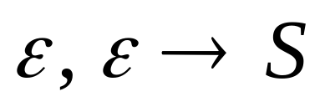
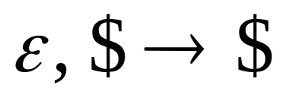



Conversion Procedure:
For each
For each
production in
terminal in
Add transitions

Slide 8
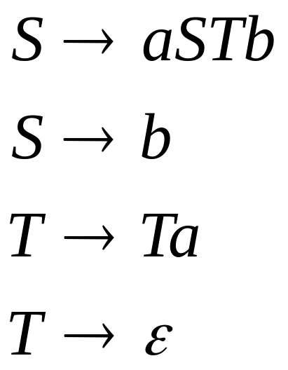
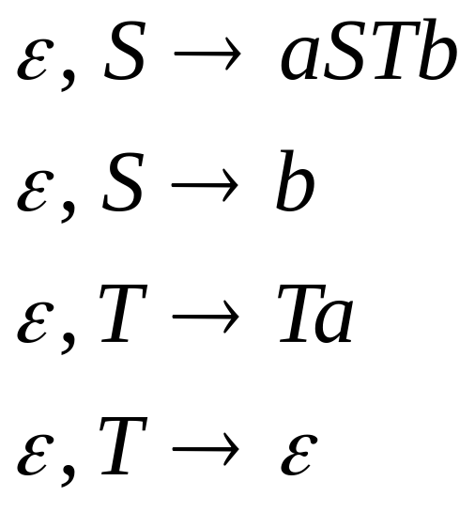
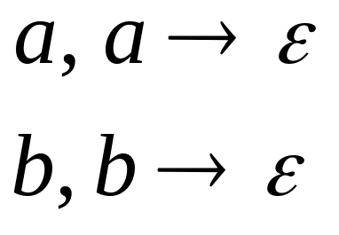
Example
Grammar
PDA

Slide 9
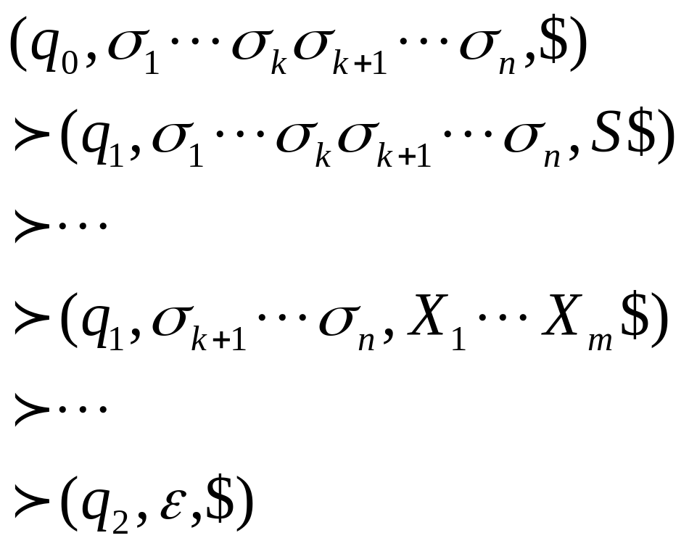
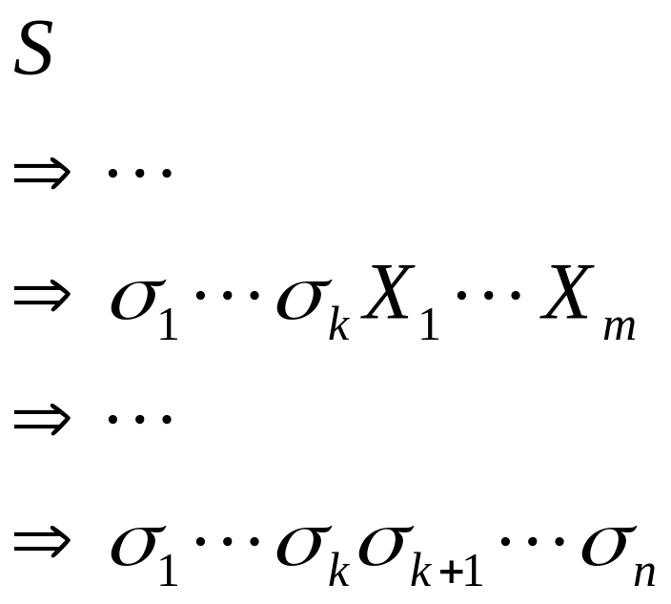
PDA simulates leftmost derivations
Grammar
Leftmost Derivation
PDA Computation
Scanned
symbols
Stack
contents

Slide 10
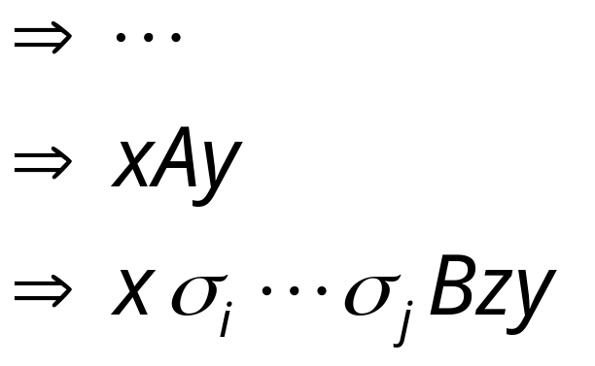
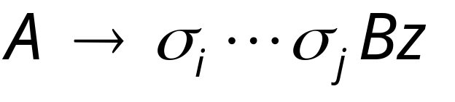
Grammar
Leftmost Derivation
Leftmost
variable
Variables
or terminals
Terminals
Production applied
Variables
or terminals
Terminals
Variable

Slide 11
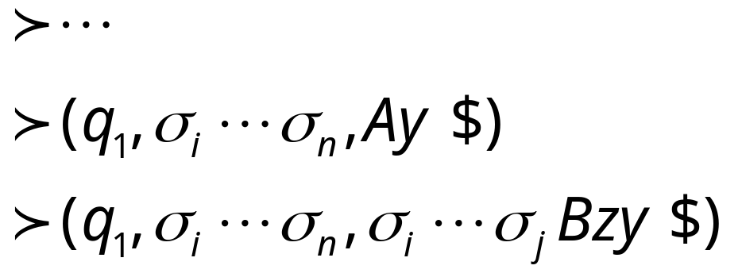
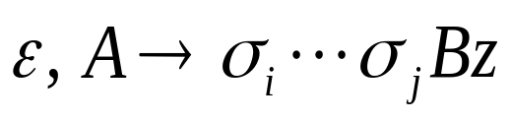
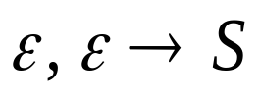
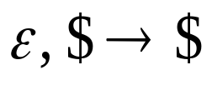
Grammar
Leftmost Derivation
PDA Computation
Production applied
Transition applied

Slide 12

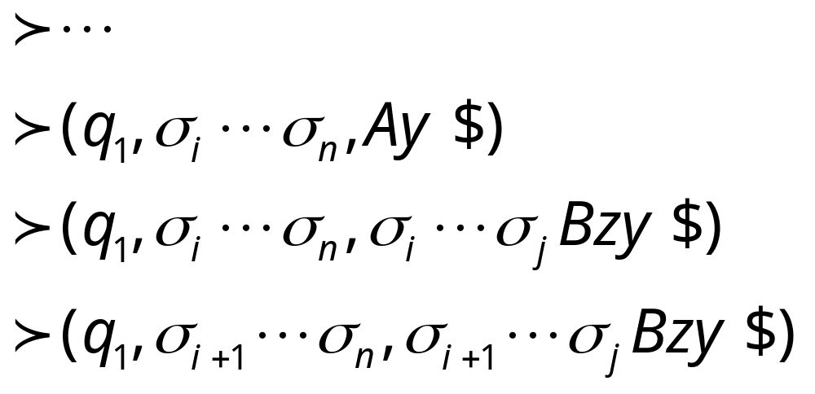
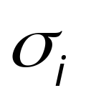
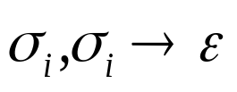
Grammar
Leftmost Derivation
PDA Computation
Transition applied
Read from input
and remove it from stack

Slide 13

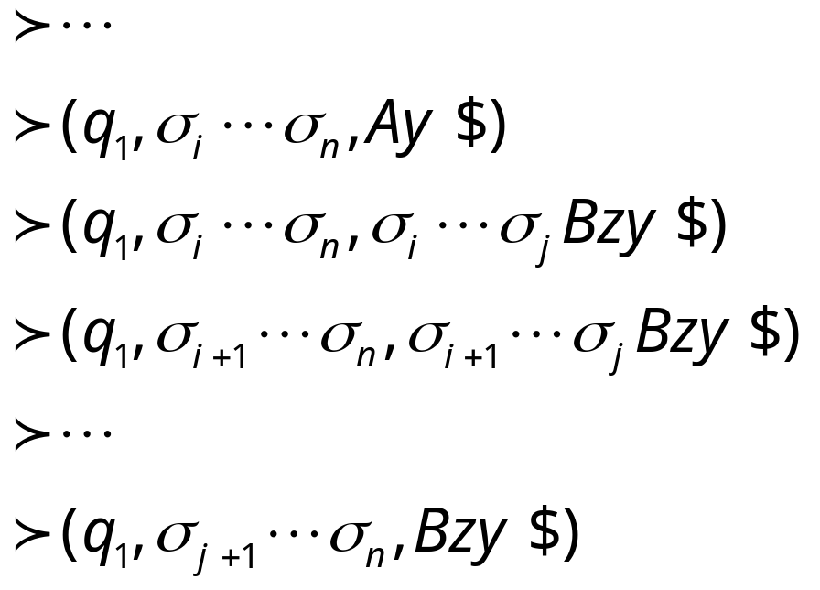
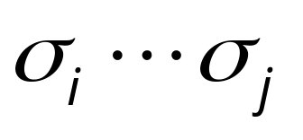
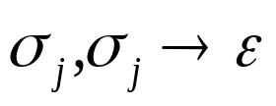
Grammar
Leftmost Derivation
PDA Computation
Last Transition applied
All symbols
have been removed from top of stack

Slide 14
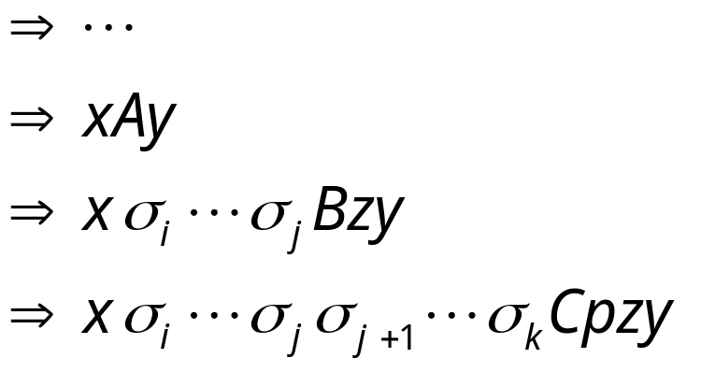
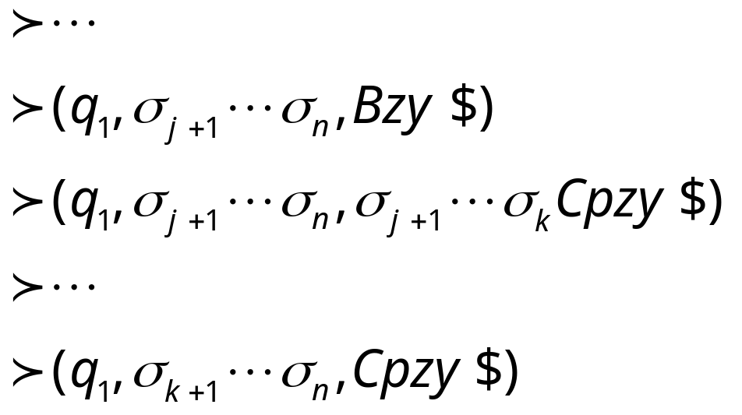
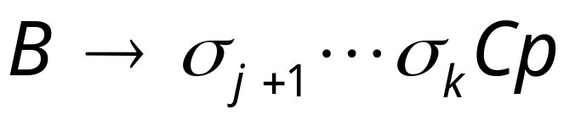
The process repeats with the next
leftmost variable
Production applied
And so on……

Slide 15




Example:
Input
Time 0
Stack

Slide 16


Derivation:
Input
Time 1
Stack

Slide 17


Derivation:
Input
Time 2
Stack

Slide 18
Derivation:
Input
Time 3
Stack

Slide 19

Derivation:
Input
Time 4
Stack

Slide 20
Derivation:
Input
Time 5
Stack

Slide 21
Derivation:
Input
Time 6
Stack

Slide 22
Derivation:
Input
Time 7
Stack

Slide 23
Derivation:
Input
Time 8
Stack

Slide 24
Derivation:
Input
Time 9
Stack

Slide 25
Derivation:
Input
Time 10
Stack
accept

Slide 26
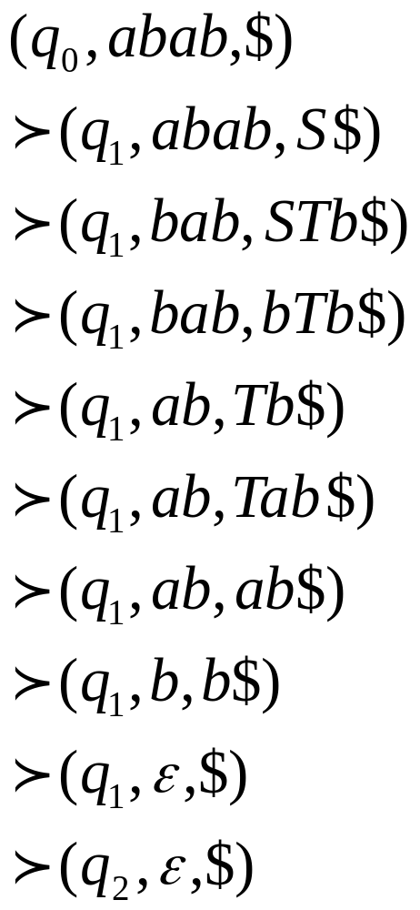
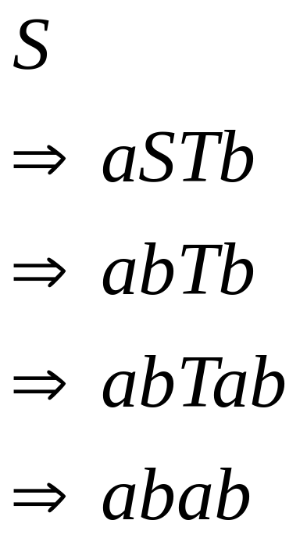
Grammar
Leftmost Derivation
PDA Computation

Slide 27

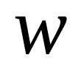
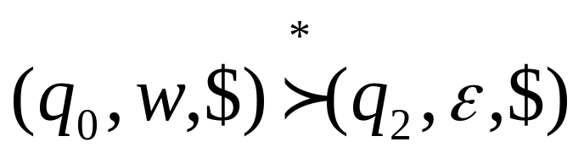
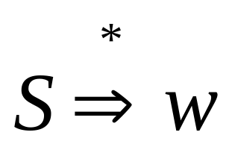
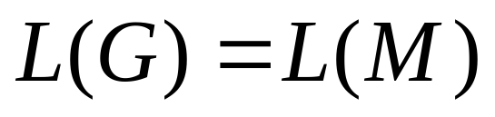
In general, it can be shown that:
Grammar
generates
string
If and
Only if
PDA
accepts
Therefore

Slide 28
Convert
PDAs to
Context-Free Grammars
Proof - step 2

Slide 29
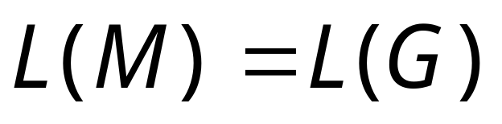
Take an arbitrary PDA
We will convert
to a context-free grammar such that:

Slide 30
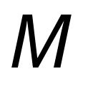
First modify PDA so that:
1. The PDA has a single accept state
2. Use new initial stack symbol #
3. On acceptance the stack contains only
stack symbol # (this symbol is not used in any transition)
4. Each transition either pushes a symbol
or pops a symbol but not both together

Slide 31
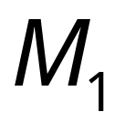
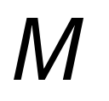
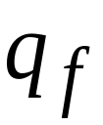
1. The PDA has a single accept state
PDA
Old
accept
states
New
accept
state
PDA
ε
,
ε
→
ε
ε
,
ε
→
ε
→
ε
ε
,
ε

Slide 32
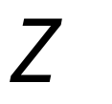

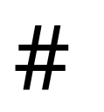
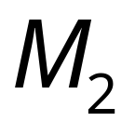
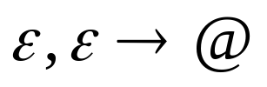
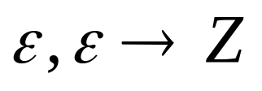
2. Use new initial stack symbol #
Top of stack
initial stack symbol of M
auxiliary stack symbol
new initial stack symbol
PDA
PDA
still thinks that Z is the initial stack

Slide 33
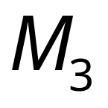



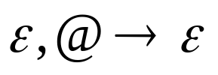
3. On acceptance the stack contains only
stack symbol #
(this symbol is not used in any transition)
PDA
Empty stack
Old
accept
state
New
accept
state
PDA

Slide 34
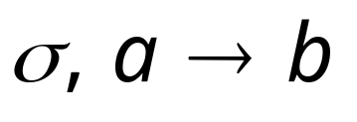


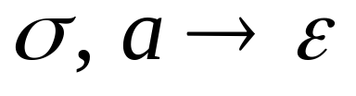
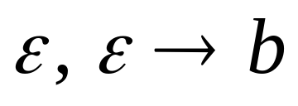
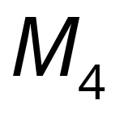
4. Each transition either pushes a symbol
or pops a symbol but not both together
PDA
PDA

Slide 35

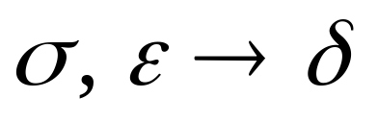
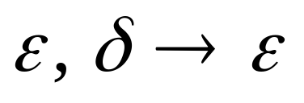
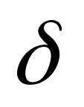
PDA
PDA
Where is a symbol of the stack alphabet

Slide 36
PDA is the final modified PDA
Note that the new initial stack symbol #
is never used in any transition

Slide 37


















Example:

Slide 38

Grammar Construction
Variables:
States of PDA

Slide 39

PDA
Kind 1: for each state
Grammar

Slide 40



PDA
Kind 2: for every three states
Grammar

Slide 41




PDA
Kind 3: for every pair of such transitions
Grammar

Slide 42


PDA
Initial state
Accept state
Grammar
Start variable

Slide 43
Example:
PDA

Slide 44

Grammar
Kind 1: from single states

Slide 45


Kind 2: from triplets of states
Start variable

Slide 46








Kind 3: from pairs of transitions

Slide 47




Suppose that a PDA is converted
to a context-free grammar
We need to prove that
or equivalently

Slide 48



We need to show that if has derivation:
(string of terminals)
Then there is an accepting computation in :
with input string

Slide 49


We will actually show that if has derivation:
Then there is a computation in :

Slide 50


Therefore:
Since there is no transition
with the # symbol

Slide 51




Lemma:
If (string of terminals)
then there is a computation
from state to state on string
which leaves the stack empty:

Slide 52



Proof Intuition:
Type 2
Case 1:
Type 3
Case 2:

Slide 53





Type 2
Case 1:
Stack
height
Input string
Generated by
Generated by

Slide 54




Type 3
Case 2:
Stack
height
Input string
Generated by

Slide 55
Formal Proof:
We formally prove this claim
by induction on the number
of steps in derivation:
number of steps

Slide 56





Induction Basis:
(one derivation step)
A Kind 1 production must have been used:
Therefore, and
This computation of PDA trivially exists:

Slide 57


Induction Hypothesis:
derivation steps
suppose it holds:

Slide 58

Induction Step:
derivation steps
We have to show:

Slide 59
derivation steps
Type 2
Case 1:
Type 3
Case 2:

Slide 60




Type 2
Case 1:
steps
We can write
At most steps
At most steps

Slide 61


At most steps
At most steps
From induction
hypothesis, in PDA:
From induction
hypothesis, in PDA:

Slide 62


since

Slide 63


Type 3
Case 2:
steps
We can write
At most steps

Slide 64

At most steps
From induction hypothesis,
the PDA has computation:

Slide 65

Type 3
Grammar contains production
And PDA Contains transitions

Slide 66



Slide 67




We know
We also know
Therefore:

Slide 68

since
END OF PROOF

Slide 69



So far we have shown:
With a similar proof we can show
Therefore:

